Slide 1
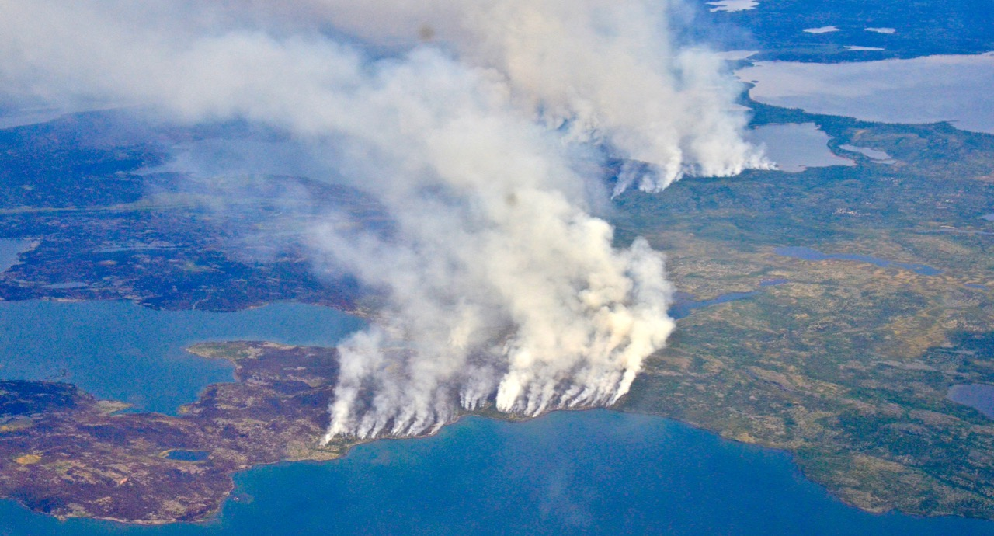
Arctic-Boreal Vulnerability Experiment
2019 Airborne Flights 12 July – 4 August
LVIS Deployment
12 July 2019
Peter Griffith
ABoVE Project Manager
NASA Carbon Cycle & Ecosystems Office
Goddard Space Flight Center
For Hank Margolis, Mike Falkowski, Bruce Tagg, Jack Kaye
NASA HQ
2019
2014 NWT Fires Northeast of Yellowknife Photo: Peter Griffith

Slide 2
12 July 2019/DOY 193
Houston – CONUS –Yellowknife
Instrument/Aircraft/Crew
LVIS Facility and LVIS Classic (GSFC)
NASA5 Gulfstream V (JSC)
REPORT DATE: 12 July 2019
Aircraft Status: GREEN
LVIS Status: GREEN
Current Deployment Location: Transit Houston to Yellowknife, Canada
Crew: W. Ehrenstrom (PIC), Kenn Cook, Alan Flint, Mike Brown, Angel Vasquez
Instrument Operators: A. Wu, D. Rabine
Data Processors: Helen Cornejo
Instrument Lead: B. Blair
Processing Lead: M Hofton
Science Lead: P Griffith

Slide 3
12 July 2019/DOY 193
Houston – CONUS –Yellowknife
Operations Summary:
Departed Houston Ellington Field
Performed calibration pitch & rolls over selected bodies of water
Generally clear with popcorn cumulus from time to time
Acquired a few of the BERMS lines
Aerosols from Alaska fires created high AOD over Peace-Athabasca Delta
Landed in Yellowknife

Slide 4
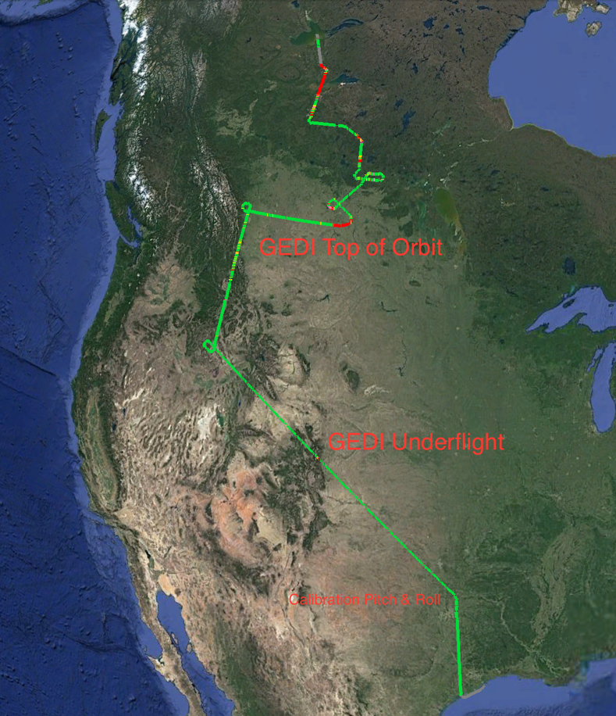
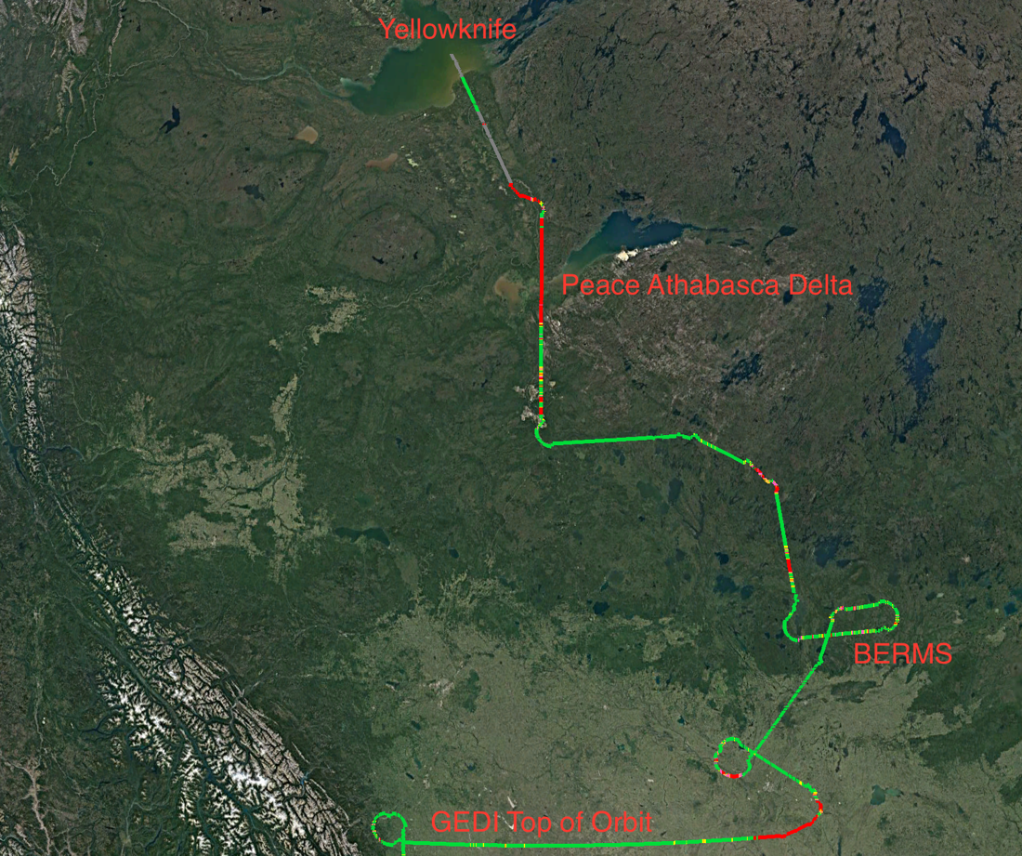
12 July 2019/DOY 193
Houston – CONUS –Yellowknife
LVIS Coverage Quality
Green = >50% returns
Yellow = >20 to 50%
Orange = 10 to 20%
Pink = 1 to 10%
Red = zero returns
Gray = returns w/o DEM

Slide 5
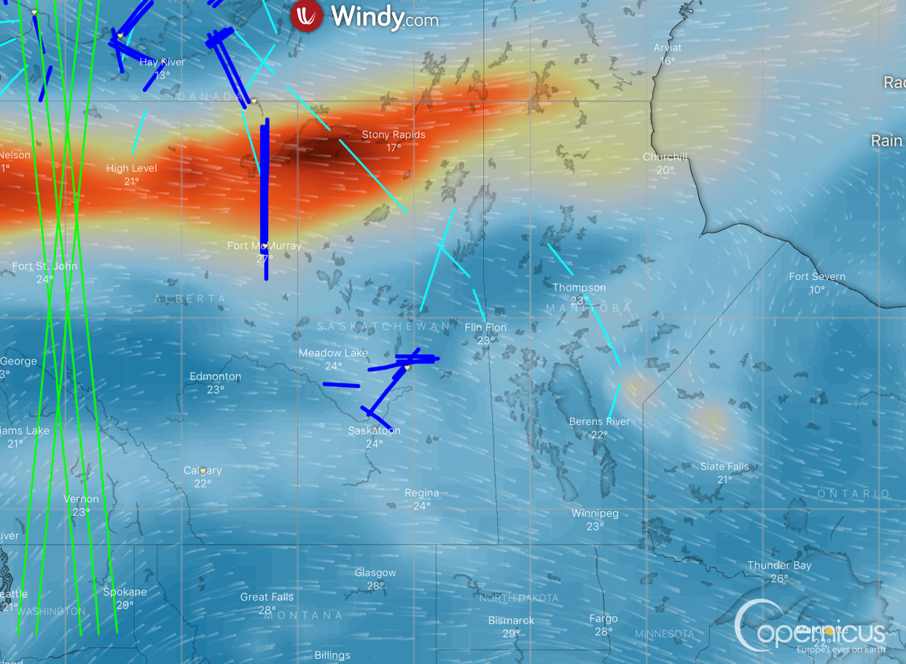
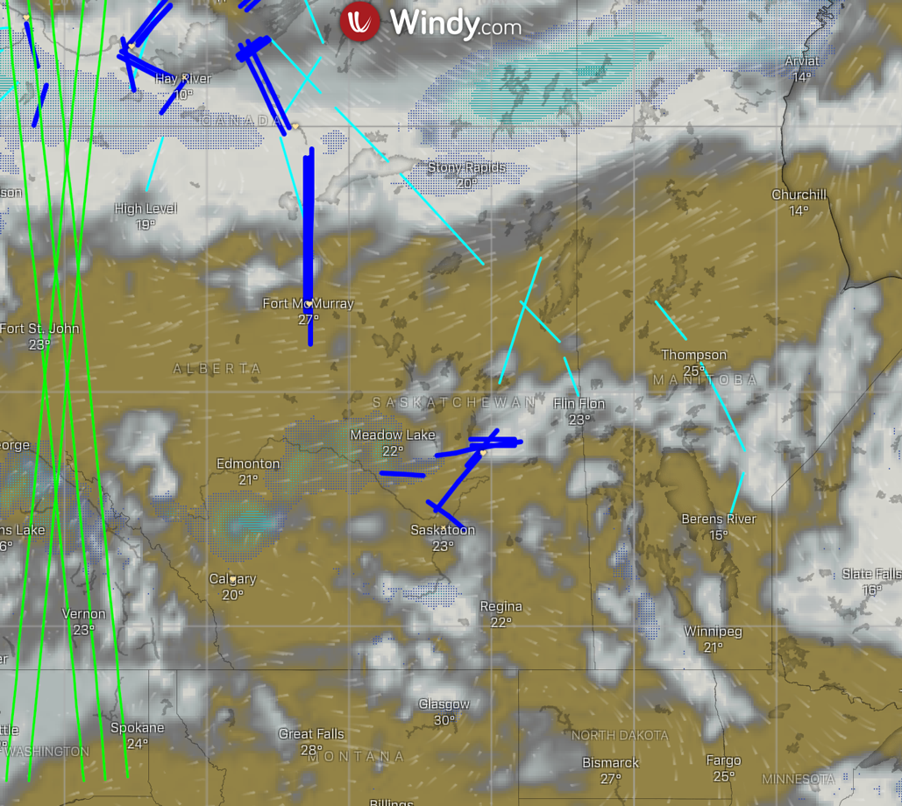
12 July 2019/DOY 193
Houston – CONUS –Yellowknife
High AOD across Peace-Athabasca Delta
Notes:
Wx
FAA Camera Locations
Windy Clouds, AOD
GMAO Wx

Slide 6
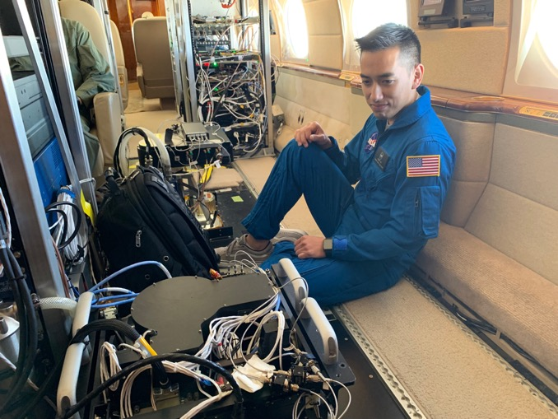
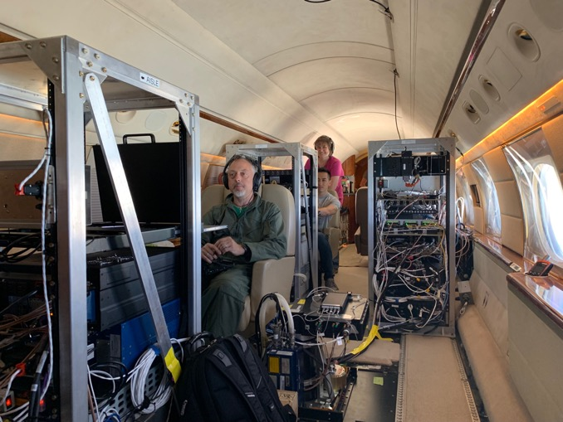
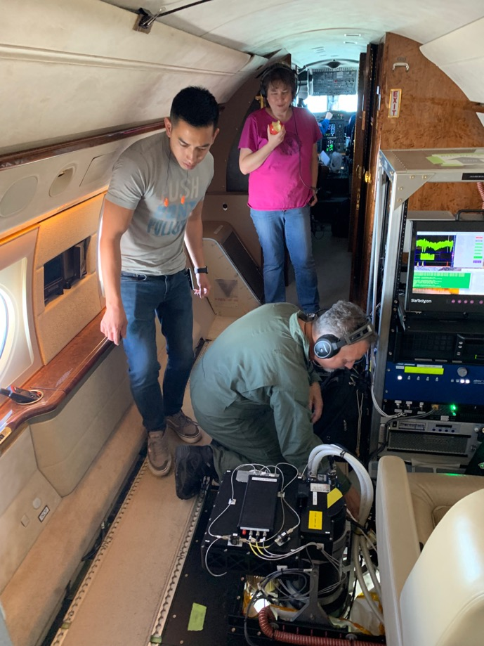
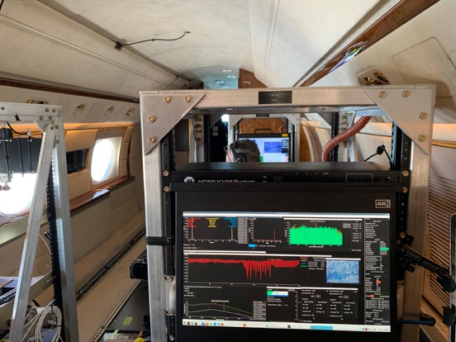
12 July 2019/DOY 193
Houston – CONUS –Yellowknife
Notes:
Photos

Slide 7
Backup

